Slide 1
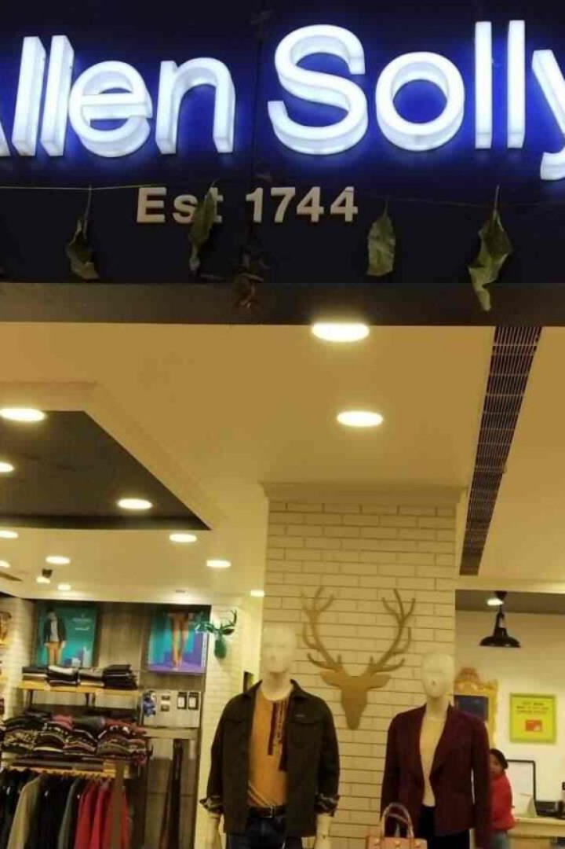
Comprehensive Digital Marketing for Allen Solly
Discover how Allen Solly leveraged the power of digital marketing to become a leader in India's fashion industry.

Slide 2

Company Overview: Allen Solly
The Beginning
The Brand
Achievements
Founded in 1744, Allen Solly was transformed into a modern brand in 1993 to cater to young Indian professionals.
Allen Solly stands for quirkiness, innovation, and individualism. It offers an eclectic mix of work and leisure wear, breakthrough designs, and exceptional quality.
Allen Solly was ranked as India's Most Trusted Apparel Brand by TRA Research in 2019. It has won numerous accolades for its marketing campaigns and e-commerce initiatives.

Slide 3
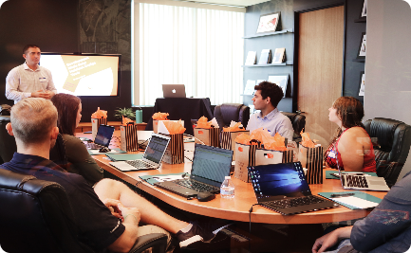


Digital Marketing Strategies
Integrated Marketing Communication
Personalization & Customer Experience
Social Media Strategy
Allen Solly has a strong social media presence, with engaging content and influencer partnerships that appeal to its target audience.
Allen Solly's campaigns leverage multiple channels of communication, such as TV, social media, email, and in-store promotions.
The brand uses customer data to offer personalized recommendations and seamless online and offline shopping experiences.

Slide 4

Brand Study, Competitor Analysis & Buyer’s/Audience’s Persona
1
Brand Identity
Allen Solly's brand identity reflects its core values of simplicity, innovation, and practicality. Its products and marketing campaigns embody these values.
2
Competitor Analysis
Allen Solly's competitors include domestic and international brands such as Louis Philippe, Van Heusen, and Zara. The brand stands out for its casual and quirky style and pricing.
3
Buyer Persona
Allen Solly's target audience is young, urban, and aspirational professionals who value individuality, creativity, and comfort. They prefer to shop online and use social media to stay connected.

Slide 5

Search Engine Optimization (SEO)
1
Keywords
2
Content Optimization
All campaigns are based on strong research and multiple layers of in-depth analysis to find the best-suited keywords.
Allen Solly's blog and website are optimized to rank high in search engine rankings to improve visibility.
3
Link building
The brand has a strong backlink program that builds backlinks from authoritative sources to improve the search engine ranking results.

Slide 6
Pay-Per-Click Advertising (PPC)
1
Strategy & Planning
Allen Solly targets the right keywords through a highly-researched and tested approach with clear objectives and budget allocation.
2
Creative Ad Copies
Ads are created with powerful headlines, multiple variations, and compelling ad texts aligned with specific targeted keywords.
3
Bid Management & Monitoring
Allen Solly's digital marketing team continuously monitors the performance of the ad campaigns and makes changes to maximize the Ad-Rank while minimizing the cost-per-click.

Slide 7
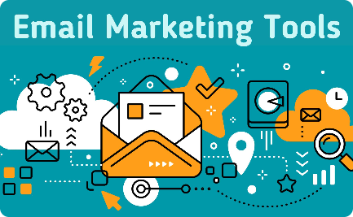
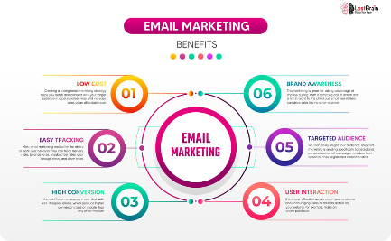
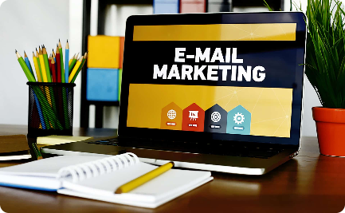
Email Marketing
Segmentation
Personalization
Engagement & retention
Allen Solly has a highly optimized email marketing list to, deliver appropriate and personalized content to a defined audience.
The brand's marketing e-mails utilize user data to craft personalized messages, leading to higher engagement rates.
The brand manages a healthy customer retention rate, driving a positive ROI, and keeping customers engaged through a variety of incentivizing campaigns and free resources.

Slide 8

Influencer Marketing
Campaign planning
Content Collaboration
Measurement
For each campaign, Allen Solly seeks the right mix of influencers that will attract the target audience's interest through a mix of social media, website promotions, and interviews.
The brand works in collaboration with influencers to develop content that aligns with both parties' brands and provides value to the audience.
Allen Solly leverages custom tracking and measurement toolkits to measure influencer value based on accurate data, such as engagement rates and cross-channel performance.

Slide 9
Key Metrics for Measuring Digital Marketing Success
Metric
Description
Customer Acquisition Cost (CAC)
The expense of acquiring new customers divided by the number of new customers
Customer Lifetime Value (LTV)
The amount a customer is worth in terms of total revenue they are expected to generate for Allen Solly during their lifetime
Return on Investment (ROI)
The measure of the revenue generated against the marketing spend.
Conversion Rate (CR)
The rate at which potential customers who visit a website take required actions. This can be a phone call, an email registration, or direct purchase

Slide 10
PRESENTED BY:
B.HARSHITHA (Team leader)
M.HARI CHANDANA
S.KOTI REDDY

Slide 11
THANK YOU

